Slide 1
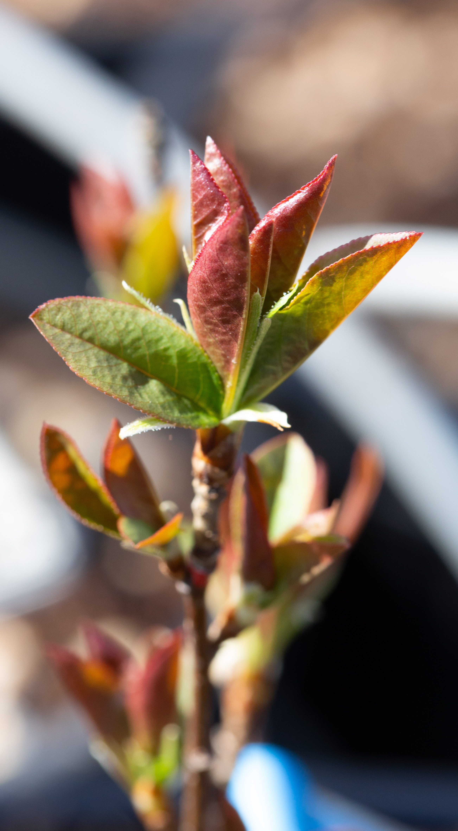
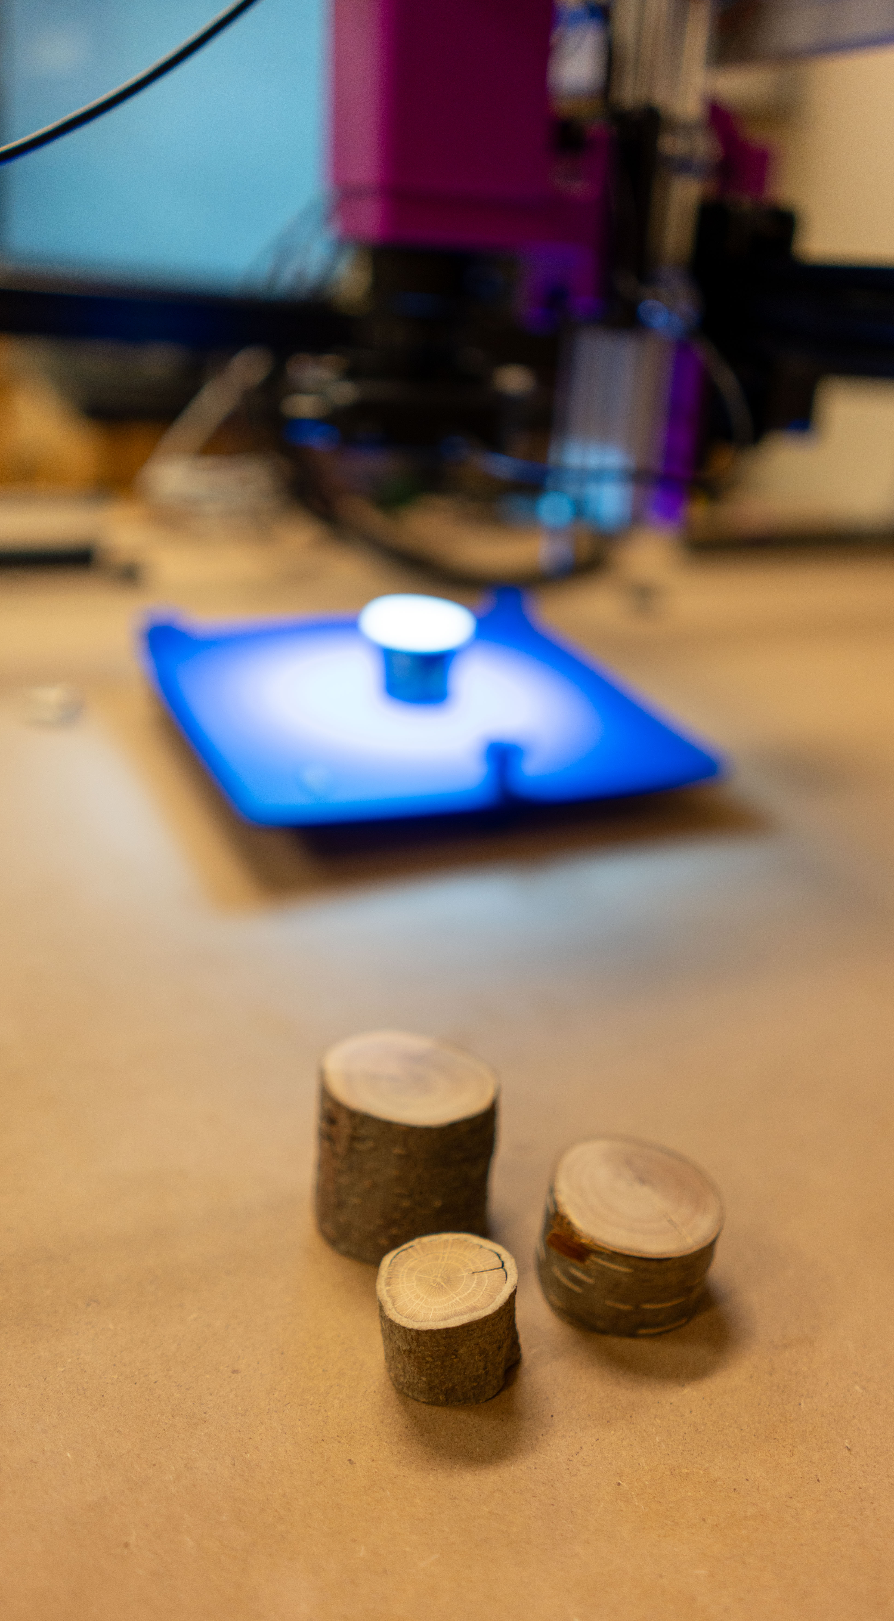
How growing season length affects tree growth
Common garden study using leaf phenology and tree ring data

Slide 2
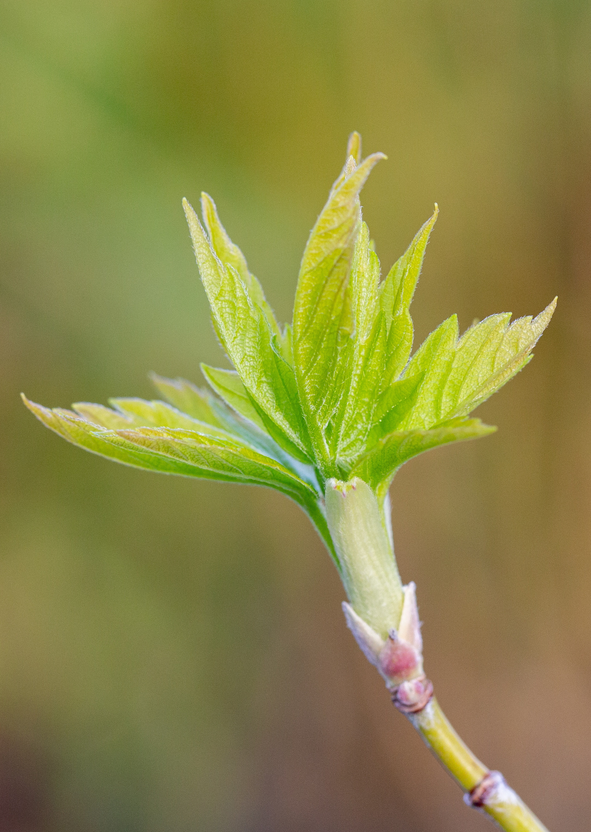
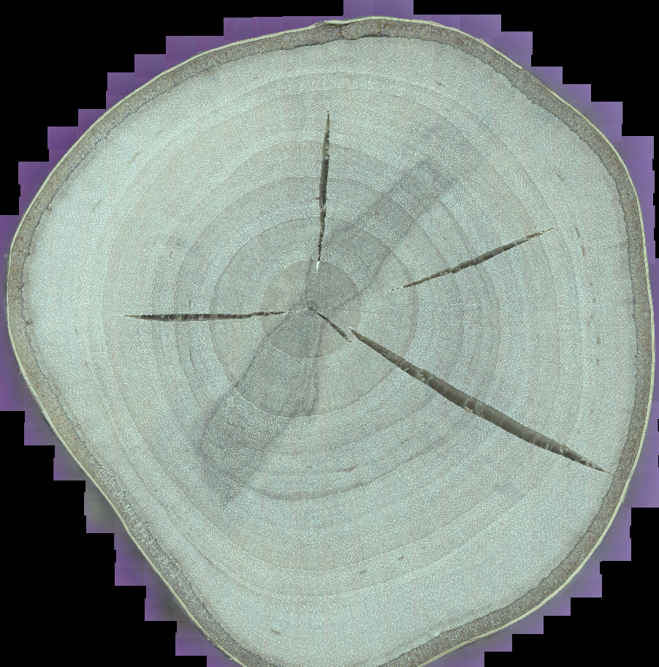

Context
Common garden trial (trees from different provenances planted together) from 2016 to 2022 (4-6 growing seasons)
Leaf phenology from 2018 to 2020 (3 growing seasons)
91 cookies
4 species
4 provenances

Slide 3
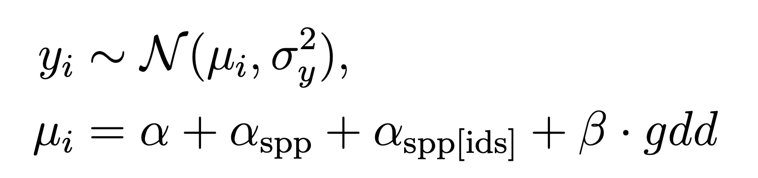
Goals
Understand how growing season length affects ring width in a common garden trial
Growing season length measured by growing degree days (GDD) between budburst and budset
Likelihood and linear model:

Slide 4
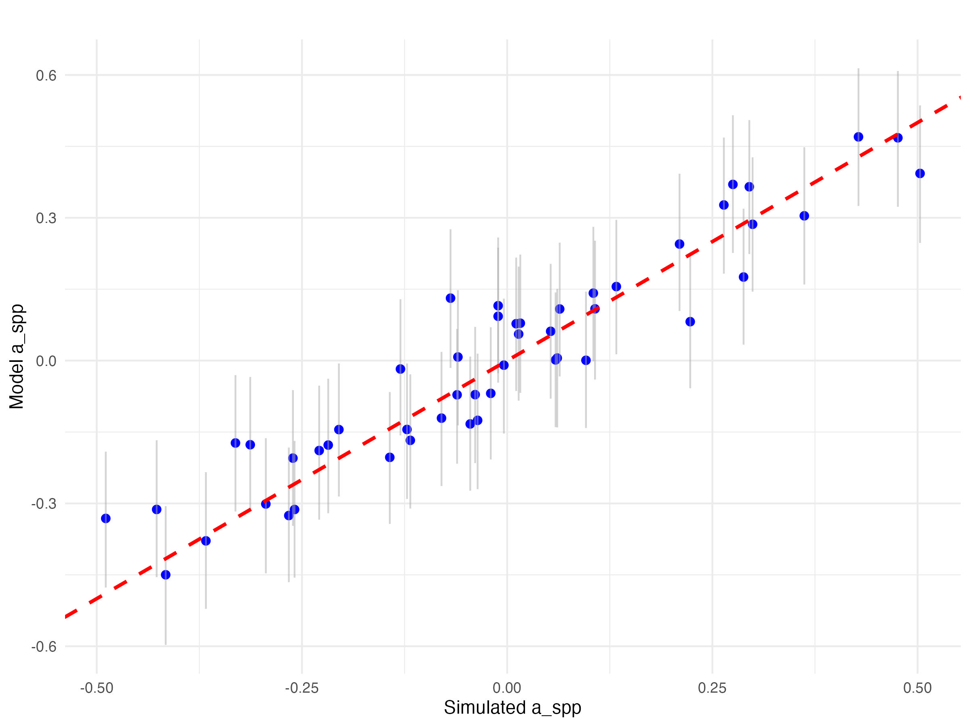
What’s been done so far
Simulated data: Partial pooling on the intercept for each species
Recovered parameter
Integrated nesting individual -> species (in progress)

Slide 5
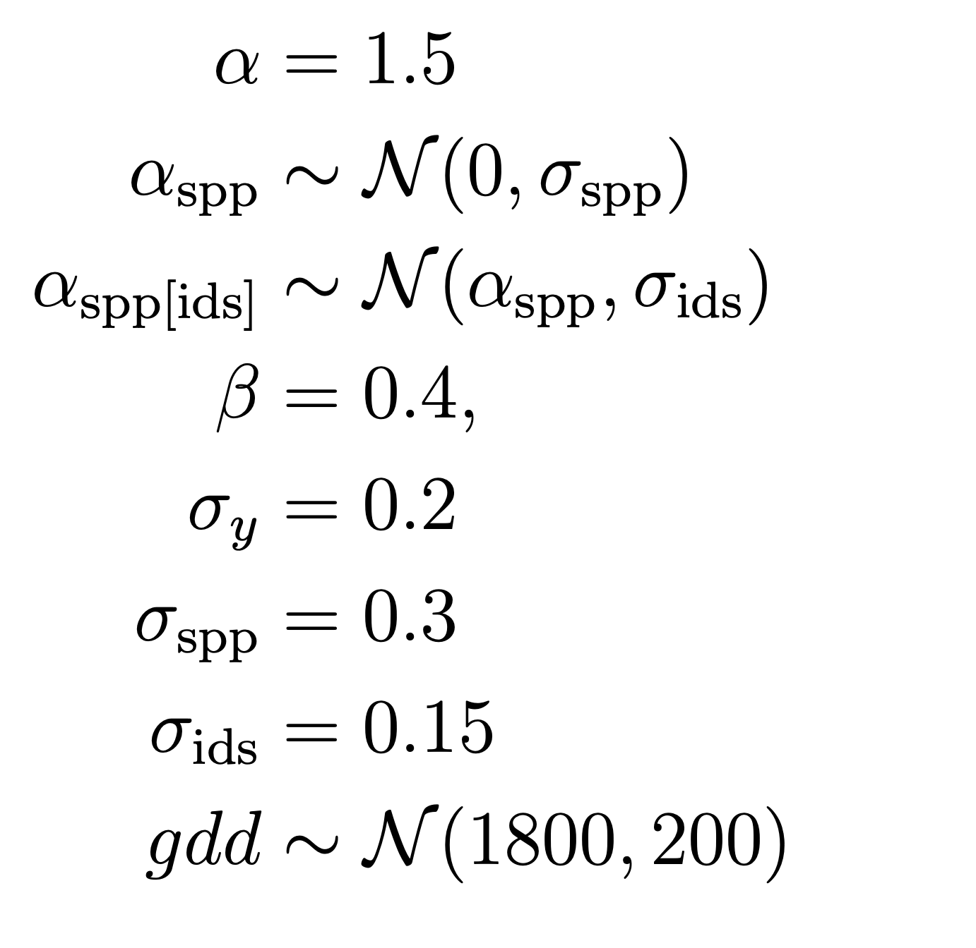
Coefficients used to date to simulate data

Slide 6
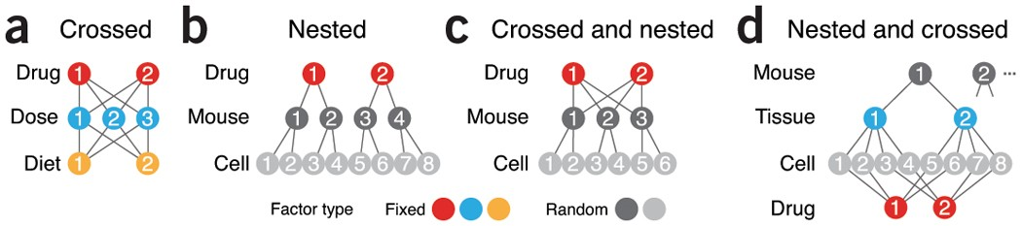
Crossed vs nested design
Site
Species
Individual tree
Krzywinski, 2014

Slide 7
Crossed and nested?
Species crossed through sites and individual trees nested within species
Site
Species
Individual tree

Slide 8
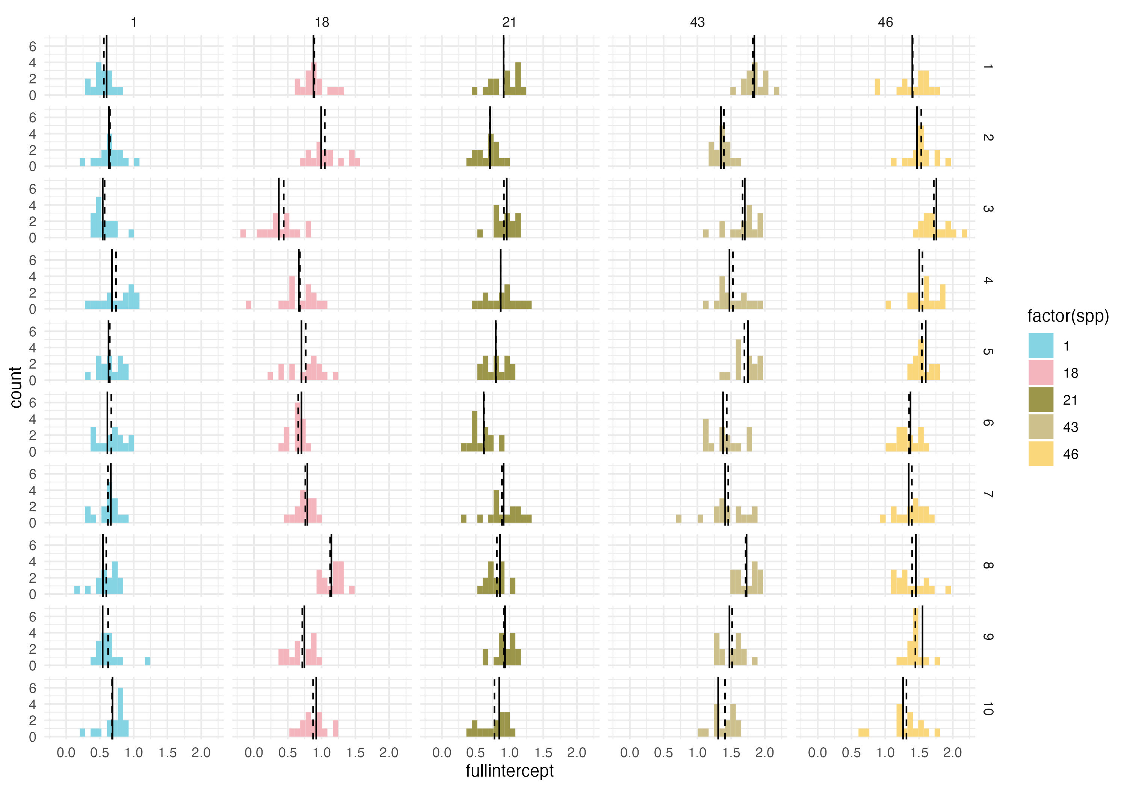
Parameter recovery for “partial” model
Intercept-only model to test how well I can recover my different intercept values
a + a_spp + a_ids

Slide 9
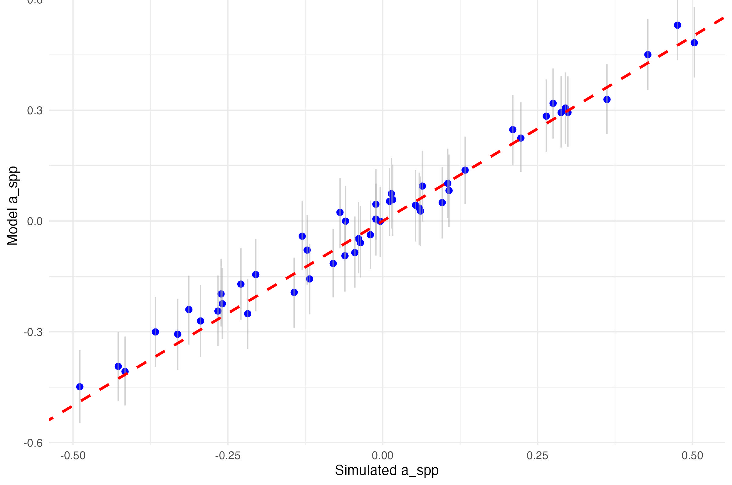
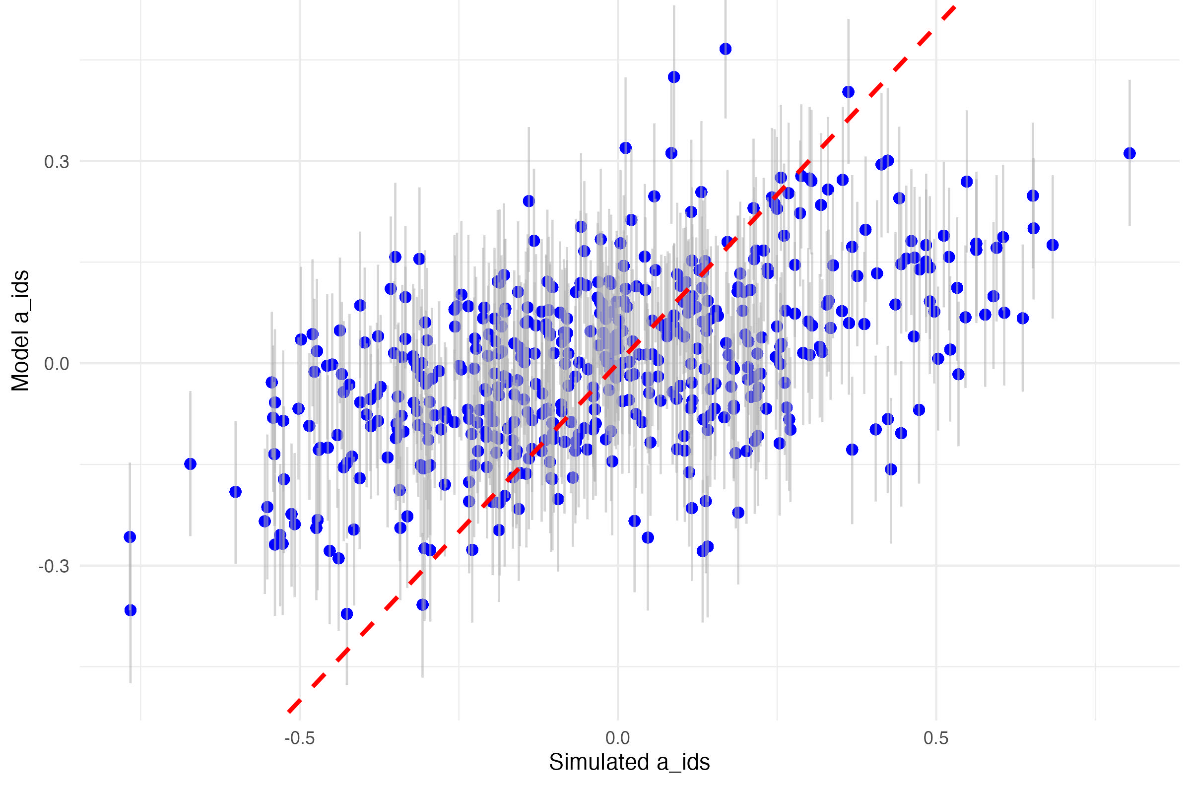
Failing at parameter recovery for the full model

Slide 10
Help with
Should I cross my species through sites in addition to nest individuals within species?
Should I also nest my ids in species for the slope?
Why can’t I recover a_ids_spp properly?
Should GDD vary across species?
In empirical data, this would be driven by spp and their provenances (because budburst and budset are genetically control)
Ok to coarsely simulate the same way across all individuals?

